Slide 1


Ali’ Cafe
A Simple Café Website Project
Client-Side Web Development
Ali Raad

Slide 2
Objective
Brief: Build a simple, functional website using HTML and CSS.
Goals: semantic HTML, navigation, forms, tables, images

Slide 3
Pages Overview
Home Page
Menu Page
Order Page
Contact Page

Slide 4
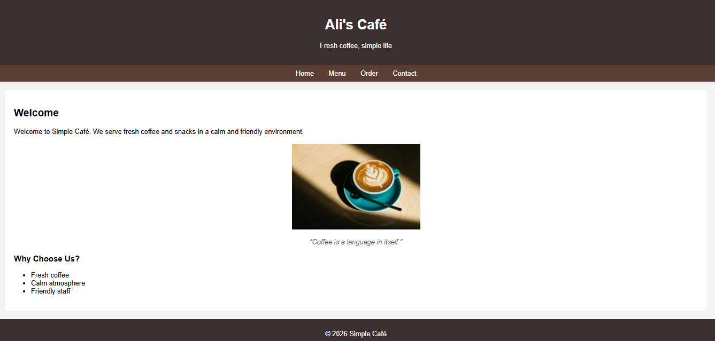
Home Page

Slide 5
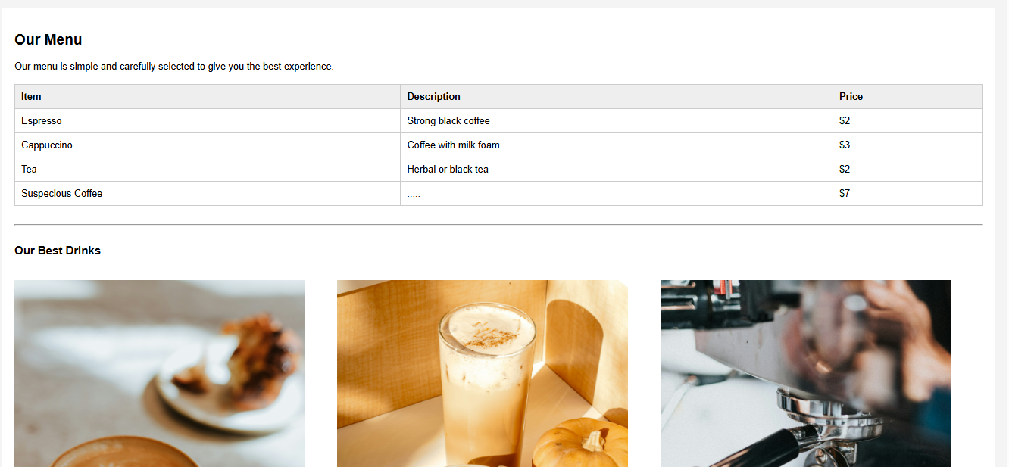
Menu Page

Slide 6
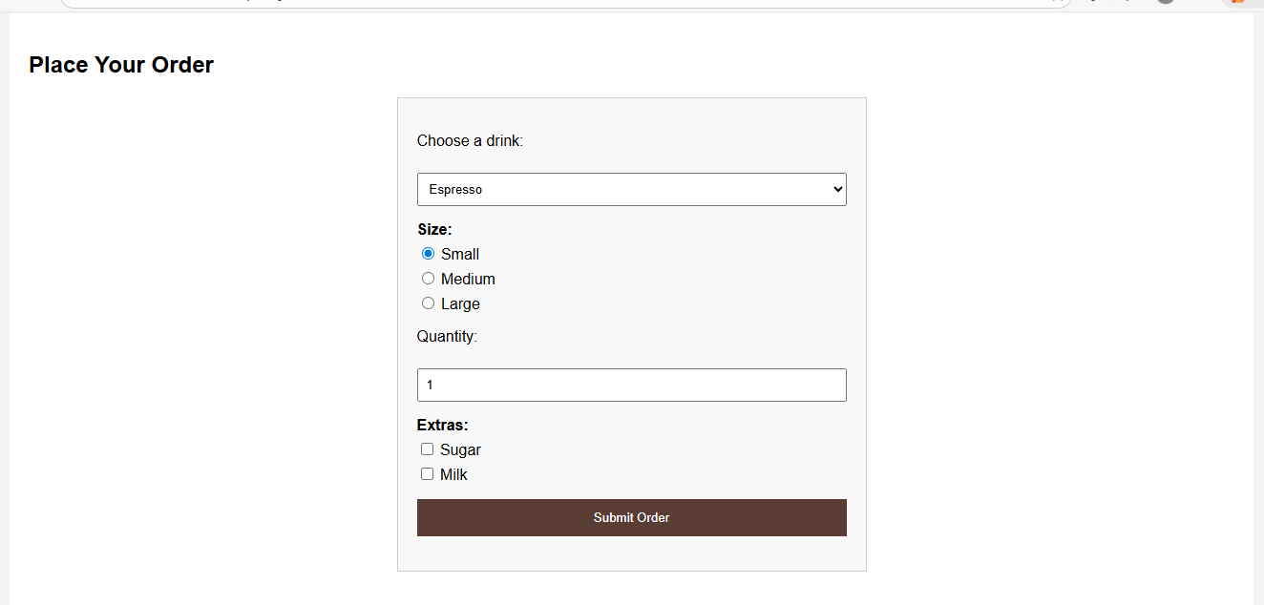
Order Page

Slide 7
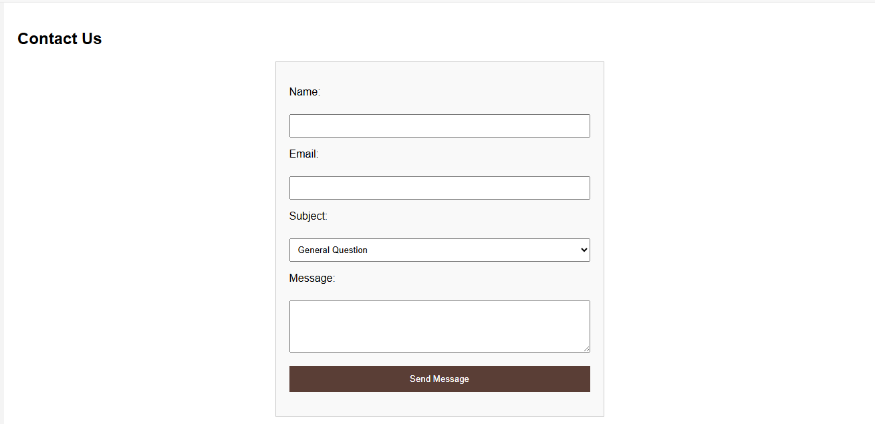
Contact Page

Slide 8
CSS Styling
Choosing the brown color pallet to make the website suited for a café
Making everything centered and easy to look at
Aligning all checkboxes and radio buttons for easier work

Slide 9
Site Advanteges
The site have everything you need to know about coffee
01
It covers everything we took in class regarding html and css
02
It looks good
03

